Slide 1
Power efficient mini inverter
TTAADC POLYTECHNIC INSTITUTE
DIPLOMA ELECTRICAL ENGINEERING FINAL YEAR PROJECT

Slide 2
POWER EFFICIENT MINI INVERTER
GROUP MEMBERS: - SOUVIK DEBBARMA
PRATIM DEBBARMA
RAJESH RUPINI
SOUMYADWIP DAS
SOURAV DAS
GUIDED BY: - SIR DEBAJYOTI DEBBARMA

Slide 3
CONTENTS
PURPOSE
INTRODUCTION
HISTORY OF INVERTER
USES OF INVERTER
ADVANTAGES
CURRENT FEATURES
COMPONENTS REQUIRED
IC 4047
WORKING OF AN INVERTER
CHARACTERISTIC OF A GOOD INVERTER
MOTIVATION
CONCLUSION
SCHEMATIC DIAGRAM
LAYOUT DIAGRAM

Slide 4
ABSTRACT
A power electronics device which converts DC power to AC power at required output voltage and frequency level is known as inverter. Inverters are used for many applications, as in situations where low voltage DC sources such as batteries, solar panels or fuel cells must be converted so that the devices can run off of AC power. One example of such as battery to run a laptop, TV or cell phone.

Slide 5
PURPOSE
Today virtually all household appliance and other major electrical fixtures and equipment can be run by an inverter. In the event of a power shutdown, an inverter is extremely useful as an emergency backup power unit. This project can be used for the small places, camping sites and etc. ,the other reason to develop this project is so that we can learn many more about new things.

Slide 6
INTRODUCTION
Power efficient mini inverter is an electrical device which converts direct current (DC) to alternating current (AC) the converted AC can be at any required voltage and frequency with the use of appropriate transformers, switching and control circuits. Static inverter has no moving parts and are used in a wide range of applications, from small switching power supplies in computers, to large electric utility high voltage direct current applications that transport bulk power.

Slide 7
HISTORY OF INVERTER
From the late nineteenth century through the middle of the twentieth century, DC to AC conversion was accomplished using rotary converters or motor-generator sets (M-G sets). In the early twentieth century, vacuum tubes and gas filled tubes began to be used as switches in inverter circuits.

Slide 8
USES OF INVERTER
DC power source utilization applications include use of DC in motor vehicles and from batteries to power AC loads and use of energy from solar cells to power AC loads.

Slide 9
ADVANTAGES
Environment-friendly.
Suitable for small and large spaces.
Can be used in the event of a power shut down.
It requires no fuel and virtually no maintenance.
Less power consumption.
Can be operated by any batteries or solar panel.
Less expensive as compared to other commercial inverters.

Slide 10
CURRENT FEATURES
This power efficient mini inverter is small in size and which can give output voltage of 220v-230v/150w. This power efficient mini inverter can be used to power up devices such as Wi-Fi routers, mobile chargers, lights and etc.

Slide 11
COMPONENTS REQUIRED
RESISTORS
CAPACITORS
TRANSISTORS
CABLES AND CONNECTORS
DIODES
PCB
LED
TRANSFORMER/ADAPTOR
SWITCH
IC

Slide 12
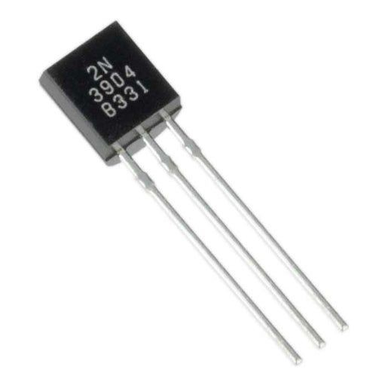
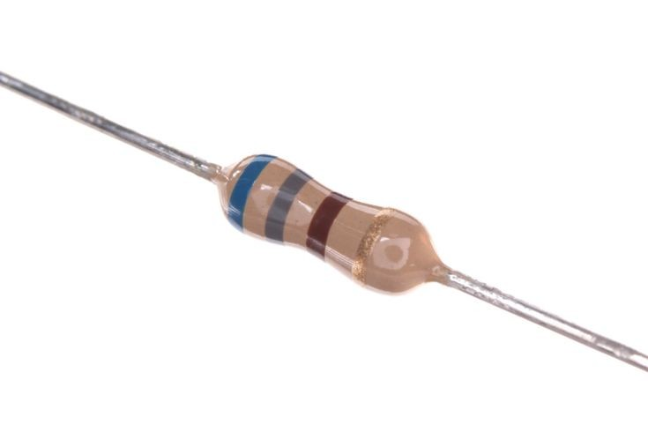
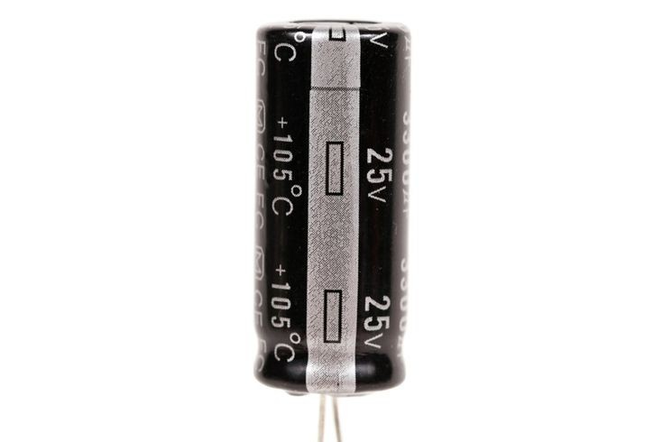
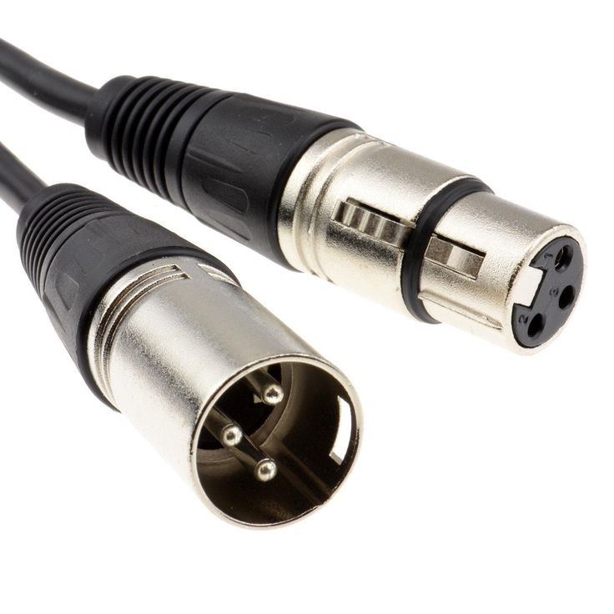
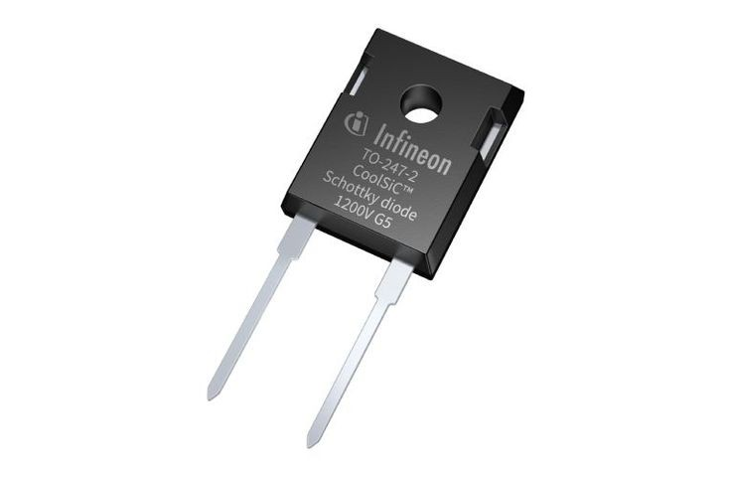
TRANSISTORS
RESISTOR
CAPACITORS
DIODE
CONNECTORS

Slide 13
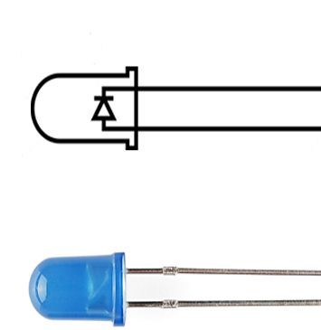
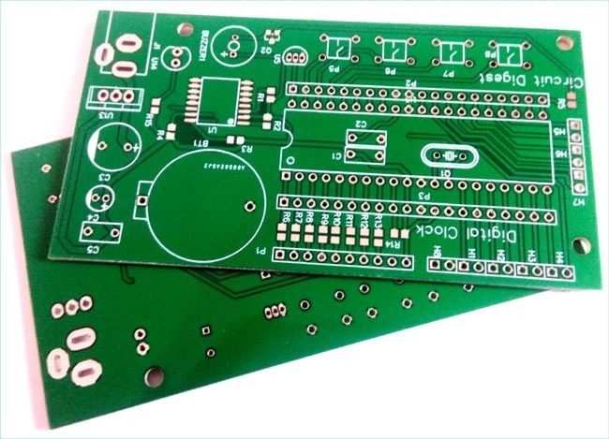
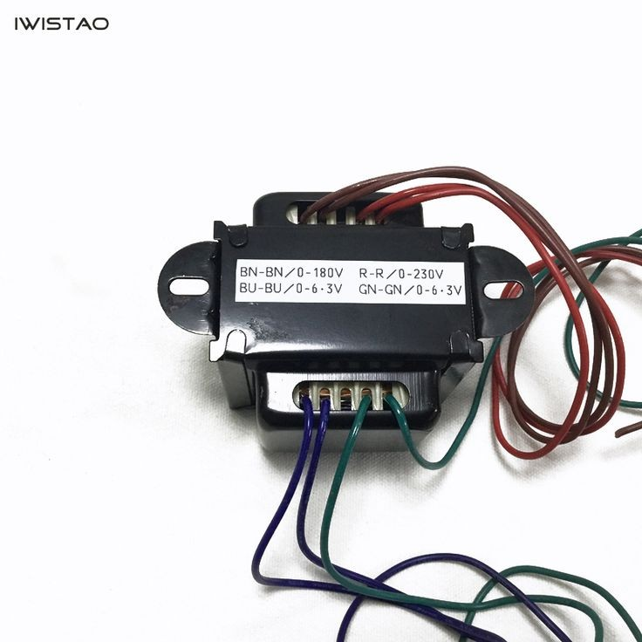
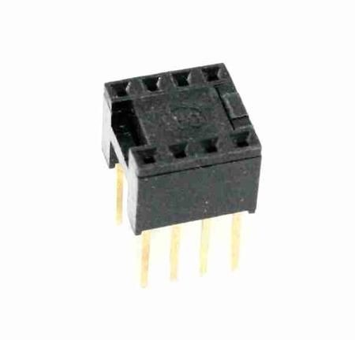
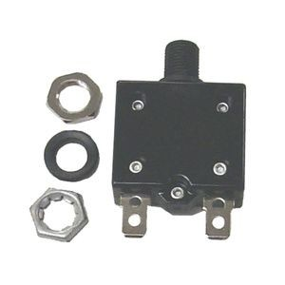
LED
PCB
TRANSFORMER
IC
PUSH BUTTONS

Slide 14
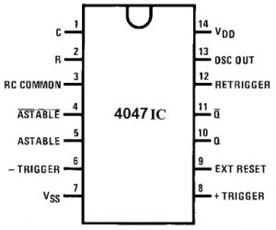
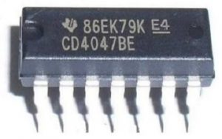
IC4047
The 4047 IC is a CMOS multivibrator that works in two modes like monostable & astable. The 4047 IC applications include a wide range like generation of the pulse wave, sine wave, and DC signal to AC signal conversion, etc.

Slide 15
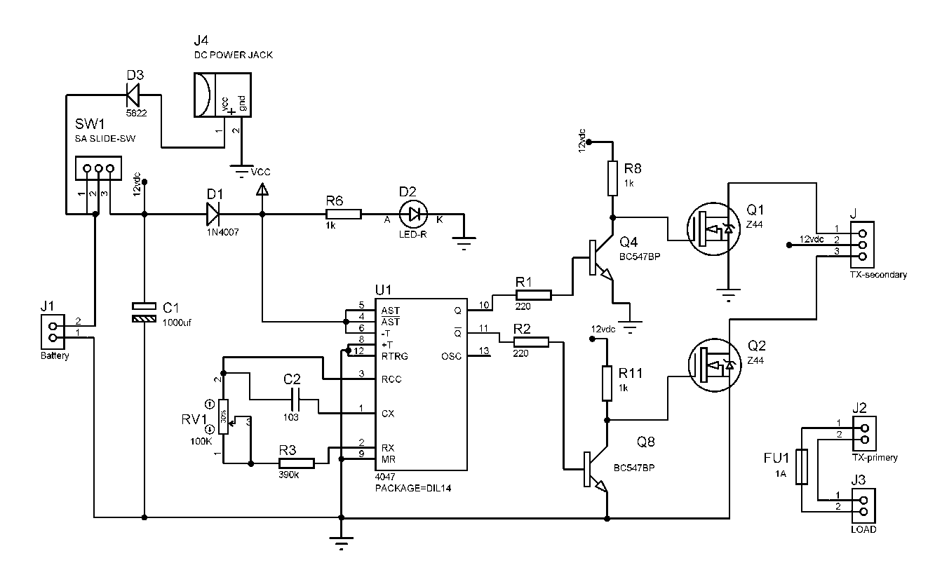
SCHEMATIC DIAGRAM

Slide 16
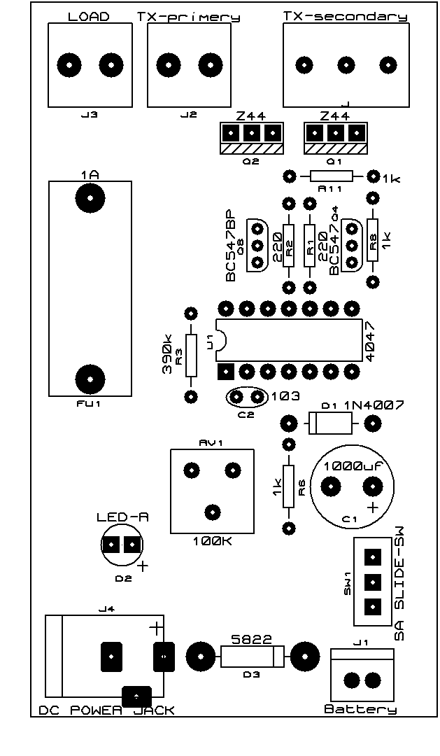
LAYOUT DIAGRAM
BLOCK DIAGRAM
Ac power source
Inverting network
DC output

Slide 17
WORKING OF AN INVERTER
Most of the inverters have the features of varying voltage and varying frequency and from this, we can say that the inverters have variable voltage design and variable frequency design.

Slide 18
CHARACTERISTICS OF A GOOD INVERTER
Its overall cost must be minimum.
Its working life must be long.
The semiconductor device is used in the inverter should be minimum switching and conduction losses.

Slide 19
FUTURE SCOPE
This power efficient mini inverter runs on microprocessor 4047 which is manual. This could be developed in future by replacing the microprocessor with more advanced microprocessor which is programmable like raspberry pi or the Arduino. These are open source platforms based on easy to use hardware and software. By the use of advanced microprocessor this inverter can be run via Bluetooth or Wi-Fi.

Slide 20
MOTIVATION
The motivation for doing this project was primarily an interest in undertaking a challenging project in an interesting area of research. The opportunity to learn about a new area of computing not covered in lectures was appealing. This area is very large for research for making efficient and economical power consumption.

Slide 21
CONCLUSION
Inverter is a simple but versatile circuit.
It is extensively used as a buffer in the output stage to reduce the loading effect of the previous stage.
Used as a basic block in many analog circuits like oscillators, amplifiers.

